Slide 1
Sustainability in school
HARLEY, JOSH ,LEWIS AND ADAM 7PM
Notes:
Adam

Slide 2
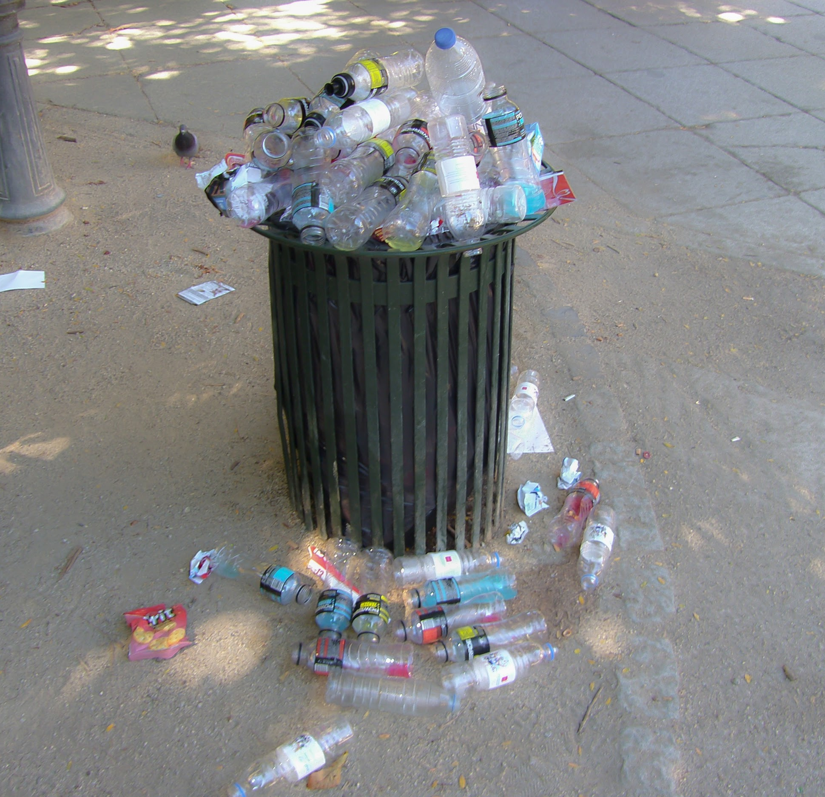
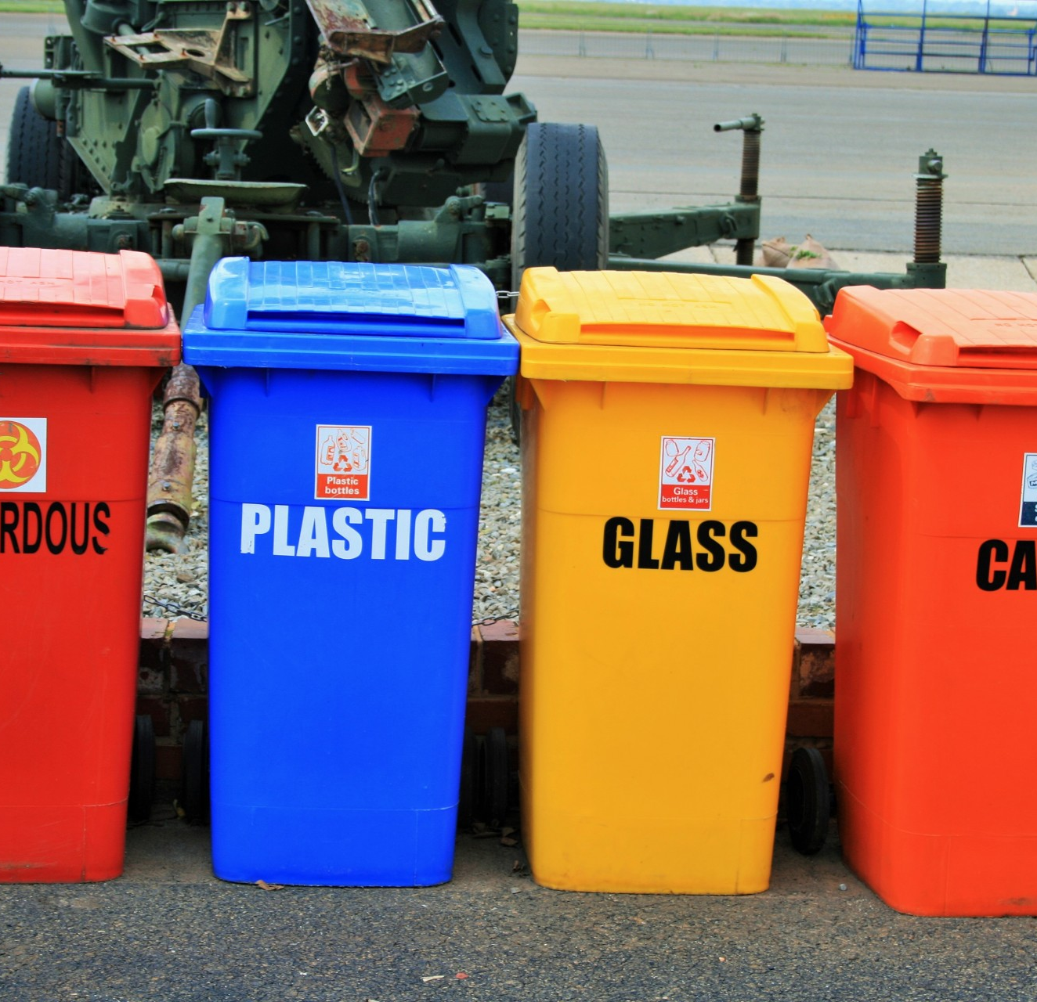
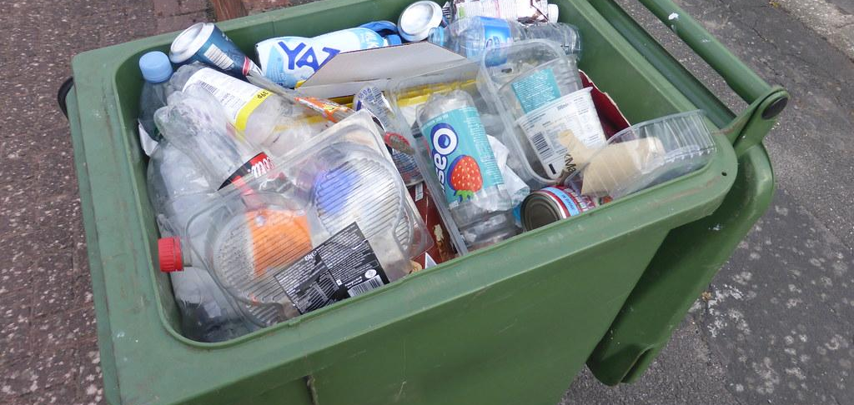
THE LACK OF RECYCLE BINS
One of the main issues around the school is the lack of bins and places to put our rubbish once we have used it. Especially in the classes where there is only one bin for all types of different waste.
Notes:
Adam

Slide 3
OUR SOLUTION
A couple of things that the school can do to help save this problem is
Buying more bins so that people can dispose of there rubbish quicker and people that can stop littering and start recycle
Another way the school could solve this issue is by spreading the bins around as there is loads of bins in the year 8 playground however there is a minimum number of bins on each of the fields.
Notes:
Lewis

Slide 4
Timeline
The project will take roughly around 2-3 weeks to install and order bins and will take a few months to see the effects. It would take a little while to get the right place to put the bins so it is affectiveand helpful to everyone
Notes:
Lewis

Slide 5
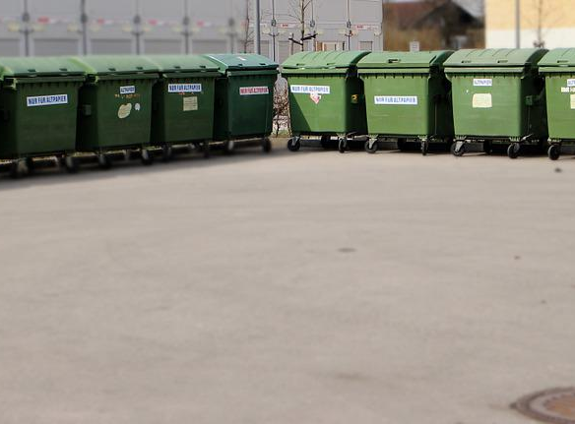
WHO IS INVOLVED
For this project the people who will need to take action is the head of the school and the deputy head. They are the ones who can take the idea further and place the order of all these bins. Also the supplier will have to agree to make all the bins to put in every different classes
Notes:
Harley

Slide 6
Measure of success
We would be able to see it has worked when there is less plastic and other types of litter scattered around the schools. Also if the man who goes around picking up the litter says that there is not as much litter on the fields which would show us that this has started to work
Notes:
Harley

Slide 7
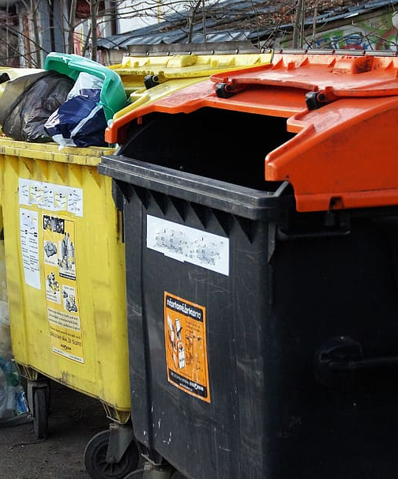
RISKS
There are a couple of risk that the school will have to be aware of. The risks consist of the older boys not caring about the new bins and continuing to litter or they could vandalise them and break them. Also there could be a crowding of bins in the class and it would be harder to move around the space available
Notes:
Josh

Slide 8
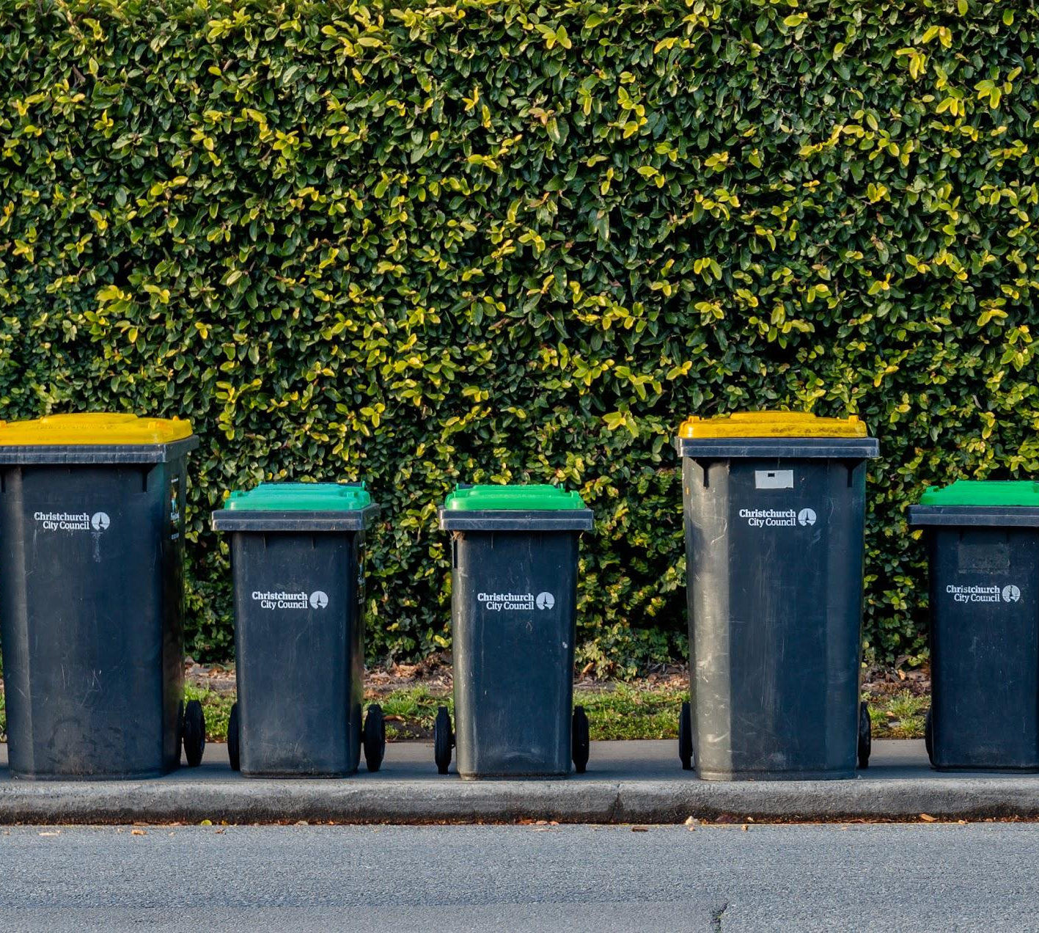
Budget
Use a good amount of money to buy bins so we could get more around the school. This will be a cost of around £500 which will set the school up in a good place for less litter and clean playgrounds
Notes:
JOsh

